Slide 1
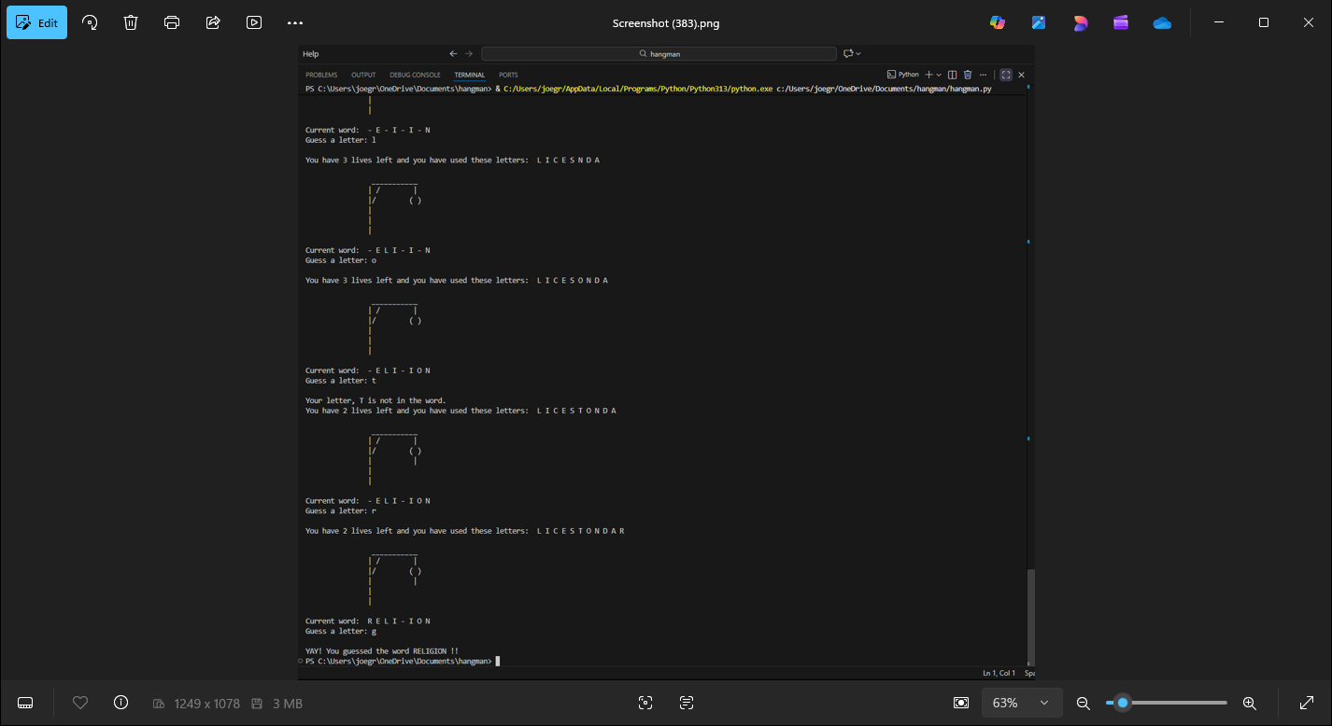
Python Arcade
The Python Arcade is a central hub for games of all kinds, including hangman, blackjack, rock paper scissors, number guessers, and a text-based adventure game! Some of the games come with visuals to enhance the user experience. The code behind each game is simple, easy to understand, and robust.

